Slide 1
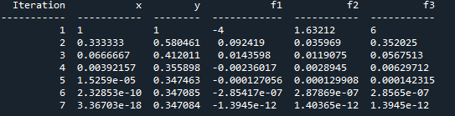
Week 7 AERO 222 Lab
Problem Assignment
Given the following 3 equations, find the nonlinear solution using Newton’s method
f1 = x^2 – 2*y^2 – 3*z = 0
f2 = -x^2 + 2*y^3 – e^(-z) + 1 = 0
f3 = X + 2*y^2 + 3*z = 0
Start with initial guesses x,y,z = 1
Iterate until the 2 norm is below 1e-6
Generate a table with the headers as shown to the right
Functions I recommend creating:
Determine jacobian
Each function f1, f2, f3
Determine the derivatives for f1, f2, f3 (either via finite differences or analytical solution)

Slide 2
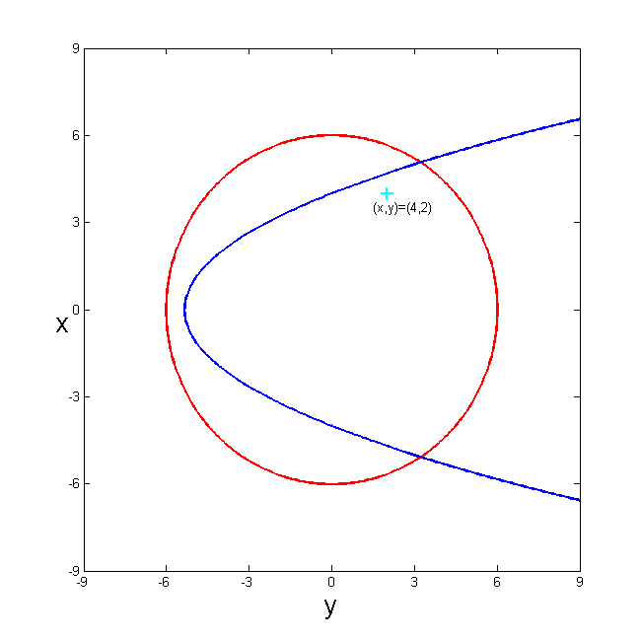
Newton’s Method
Linearize each nonlinear equation about a point and solve the system of linear equations
Linearization
Starting point : (4,2)

Slide 3
Newton’s Method (matrix form)

Slide 4
Vector and Matrix Norms

Slide 5
Examples of Vector and Matrix Norms

Slide 6
General Python Tips
Define your equations as functions
Test them out, make sure they return the correct values
Initialize your lists
Includes anything you need to track or plot
Determine your iterative
What error or an independent variable are you trying to converge?
Iterate to your solution
Keep track of which variables are inside your loop
What types of values are they?
Are you overwriting any values you need later?
End when stopping criteria is met
Plot your solution
Matplotlib.pyplot.plt
plt.plot(xList, yList (optional)) is the simplest plot
For logarithmic axis:
plt.loglog() plots both axis as log scale, plt.semilogx() plots the x axis as log scale, plt.semilogy() plots the y axis as log scale
Other tips:
Defined functions only track their specified inputs and outputs
If you redefine a variable later in your main script, it will not remember the previous value
If you redefine a single value in a list or array, it will update the array and keep the other array values
If you append a list, it will add the value to the end of the list
Use brackets for indices, parenthesis for calling functions and (if necessary) grouping/order of operations
Parenthesis immediately after a word will likely be treated as a function call
Square brackets immediately after a word will likely be treated as the index of a list or matrix
Someone, somewhere has probably run into the same problem before
Googling your errors or problems is a legitimate way to find programming solutions

